Slide 1


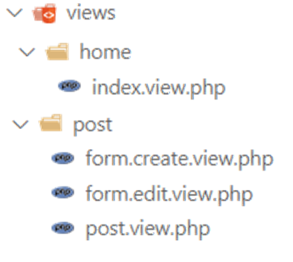
ACTIVITY
Activity 1
20 MIN
Create the view folders ( home and post)
Move the code to the views

Slide 2
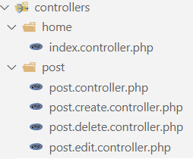
ACTIVITY
Activity 2
20 MIN
Create the controller folders ( home and post)
Create the controller files :
index.controller.php
post.controller.php
post.delete.controller.php
post.edit.controller.php
The controller get the data from database
The controller call the view using require

Slide 3
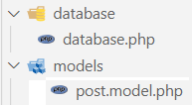
ACTIVITY
Activity 3
20 MIN
Create the model folders
Create the model files :
post.model.php
The model manage the data related to posts
The controller call the model to get the data

Slide 4
ACTIVITY
Activity 4
60 MIN
Refactor your own previous PHP project follow this new organization
Return your project (ZIP) on Google classroom

